Slide 1
Jiangsu Sterlite Tongguang Fiber Co. Ltd. Corporate Profile
www.sterlite-tg.com.cn

Slide 2








Transforming everyday living by
Delivering smarter networks
2

Slide 3
As consumers and enterprises use these technology applications,
they expect hyper connectivity and ultra low latency
Autonomous Driving
1 ms
Augmented Reality
Virtual Reality
Tactile Internet
10 ms
On the Go (Fully Mobile)
Disaster Alert
Real Time Gaming
ULTRA LOW LATENCY
Delay
Nomadic (Fixed Access with Limited Mobility)
100 ms
Personal Cloud
Wireless Cloud
based Office
1000 ms
Enabled by 5G
Video Streaming
<1 Mbps
1 Mbps
10 Mbps
100 Mbps
>1 Gbps
Bandwidth
HYPER CONNECTIVITY
Source: GSMA

Slide 4








Consumption patterns are driving the need for constantly
evolving ‘smarter’ networks
Open Source
Solutions
Dense
Networks
Big Data
Analytics
Limitless and Secure Storage
Cloud Platforms and NFV
Flexibility
Ultra Low Latency
Deep Learning / Personalisation
Hyper Connectivity
Network Efficiency
Omni Channel Digital Services
Edge
Computing
Cyber Security
Scalability
Longevity
Smarter Networks
Customer
Experience
Traceability

Slide 5










We partner with customers to Design, Build and Manage
smarter networks
CUSTOMERS
Business
DESIGN, BUILD AND MANAGE
SMARTER NETWORKS
The customer segments are
OFFERINGS
ENABLERS
Unified Data Network Solutions
GLOBAL SERVICE
PROVIDERS
GLOBAL INTERNET COMPANIES
TALENT & CULTURE
RESEARCH & TECHNOLOGY
CUSTOMER ENGAGEMENT
OPTICAL PRODUCTS
SYSTEM INTEGRATION SERVICES
TELECOM SOFTWARE
DEFENCE SERVICES
CITIZEN
NETWORKS

Slide 6
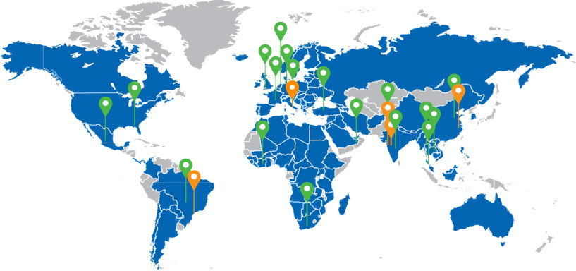
Working with eight of the top ten telco service providers globally
8/10
GLOBAL
Market Presence
SERVICE PROVIDERS
Sales Offices
Manufacturing Facilities
Strong global presence in over 100 countries

Slide 7

Key customers
China Telecom
China Unicom
China Mobile
Annual output
7 million fiber km
Main products
Single mode fiber G652D
Registered Capital
$ 20 million
Investors
Sterlite Technology Co., Ltd,
Jiangsu Tongguang information Co., Ltd
Established Time
Jan 2011

Slide 8

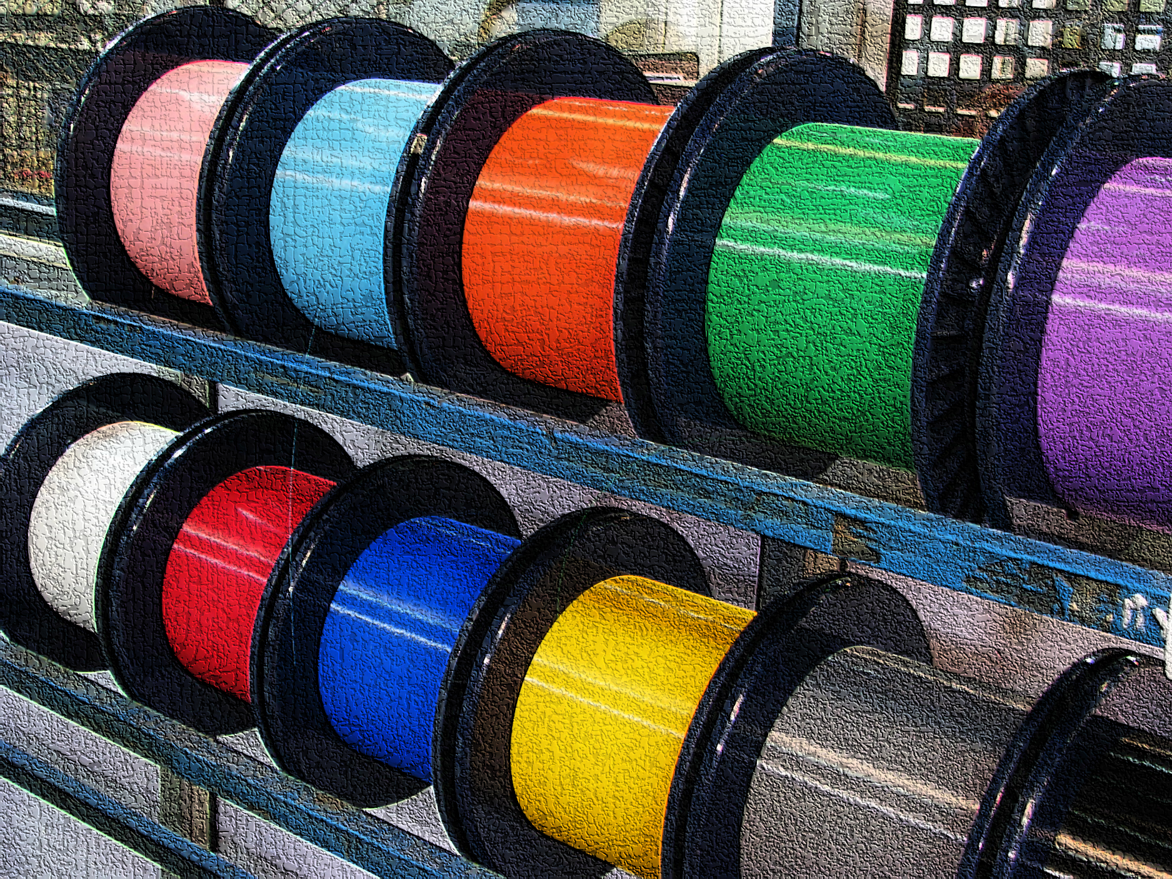
Our portfolio of Optical Communication Products
OPTICAL FIBRE & PREFORMS
OPTICAL FIBRE CABLES
STRUCTURED DATA CABLES
Full suite of ITU-T fibre products from low loss to bend insensitive fiber,
For NLD to Access Network applications
Customized cabling products
For FTTx, utilities, Oil & Gas, Transport and defense applications
For variety of applications in structured cabling – From data centers to enterprise

Slide 9
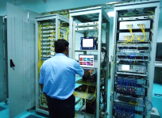
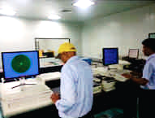
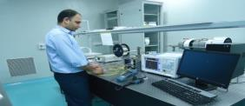
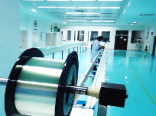
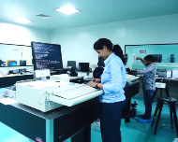
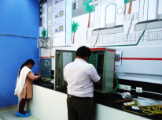
Our Value Enhancers: Global Quality Standards
Rigorous & integrated system of quality checks
Analytical controls & Comprehensive traceability procedures
Enhance Micro –bending Performance Fiber
“Low water Peak Fiber” to “No Water Peak Fiber”
World-class Testing Centre
Network Lab
Fiber Characterization
Products Tested & Certified By Renowned Laboratories
TLC
Operations Comply With Highest Worldwide Standards
IEC,GB/T 9771.3
Strength Testing
Strength Testing
We ensure our Product Quality exceeds Global Standards
10
9

Slide 10
Operational & Manufacturing Capability
Best in Class
Manufacturing Infrastructure
Manufacturing Equipment
Service Providers
Process Control
Quality Checks
Best in class raw material providers & machine OEMs for Fibre Drawing and Glass Stretching
Best in class Logistics Service Providers like:
DHL , UPS , TNT
Lean Manufacturing, 6 Sigma, 6S, Visual controls
Employee involvement concepts like “My Machine"
IT enabled traceability via SAP & CRM.
Completely IT enabled integrated system from RFQ to Sales
We engage with the Best while ensuring the Right Processes & Quality Checks are followed!
10

Slide 11










Globally certified manufacturing process to deliver the
best results
Registration, Evaluation, Authorization and Restriction of Chemicals (REACH):
Priciples
followed throughout at Production Level
G652D : OH-LITE® , OH-LITE® (E)
G.657A1 : BOW-LITE™
G.657A2 : BOW-LITE™ (E)
Product Certifications
System
Certifications
China Telecommunication Technology Labs (TTL) Chinese Govt.
G652D : OH-LITE® , OH-LITE® (E)
Our Product & System Certifications are testimonials to our superior “Quality Standards”
11

Slide 12




STEM - STERLITE TECH EXCELLENCE MODEL
N+1 = Advanced Manufacturing Techniques
Project for 15 Mnfkm Capacity Building
Project SMART
(Quality Improvement Program)
Exchange Program with STL India Plant
Continuous Improvement
Internal Assessment
OUTSIDE IN
INSIDE OUT
External Assessments
Green
Sustainability
HSE
European Customer Assessments
Forbes Innovation Assessment
Clean
Particle free Shop floor
Contamination free Product
Lean
Organization
Customer focused and LSS driven processes
Capability
Enhancement Programs
Mean
Purpose-oriented assertive people
Cross-functional teams
LSS: BB, GB, YB
Analytics
Advanced Mfg. Techniques
N-1 = Back to Basics (QMS)

Slide 13
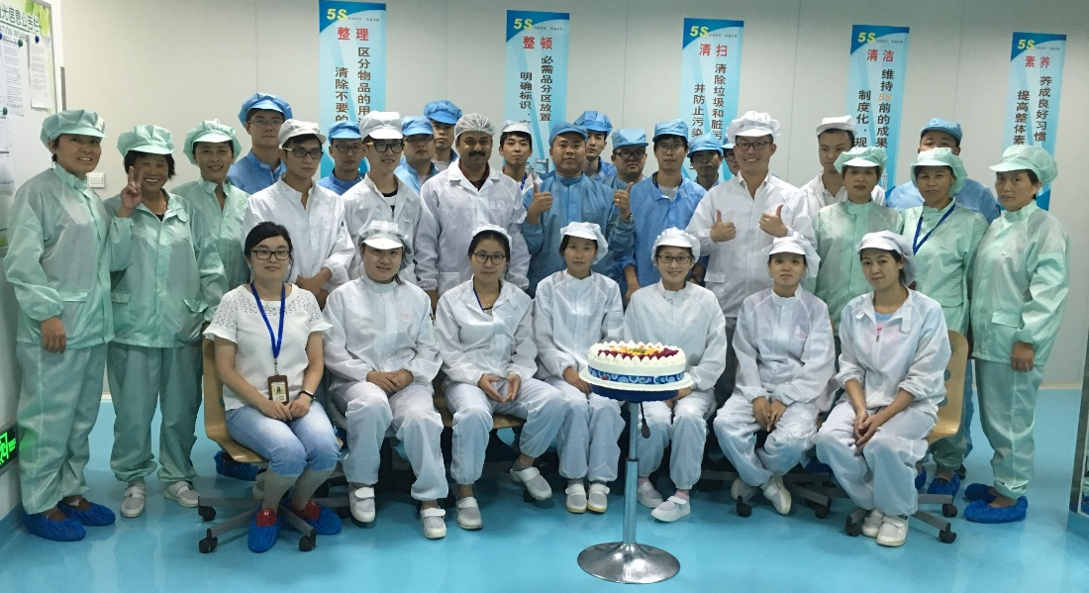




Our People – Key Asset of Excellence Framework
Current size of the Team: 266, having 3 Sr leaders, 8 supervisors and 14 managers.
Adding up the manpower to 350 while expanding the capacity.
PROMISES DELIVERED
HUNGER TO LEARN
RESPECT, EMPATHIZE
KEEP IT SIMPLE

Slide 14
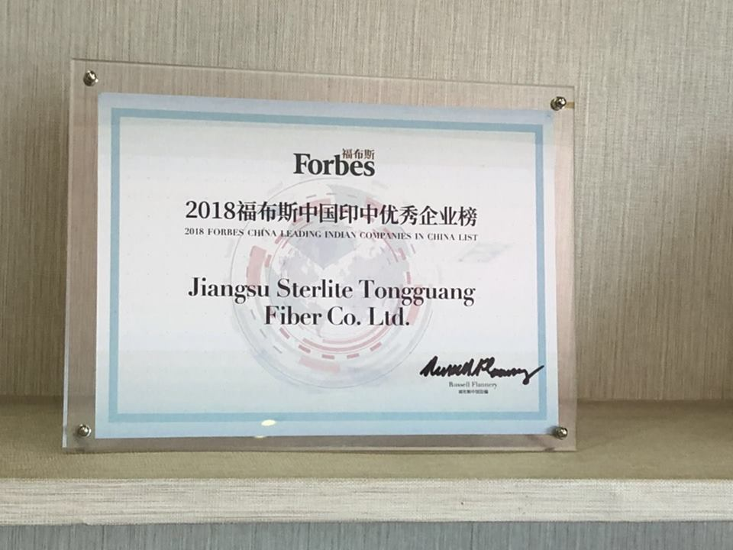
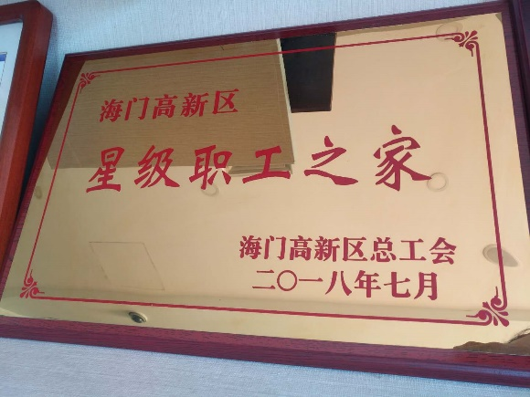
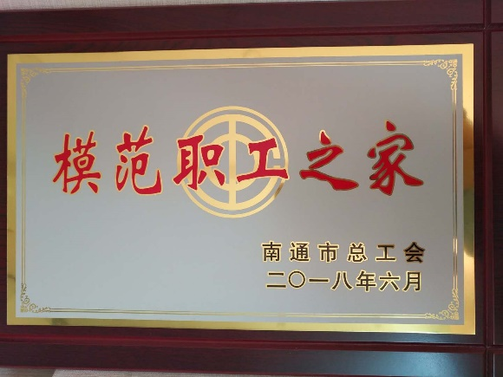
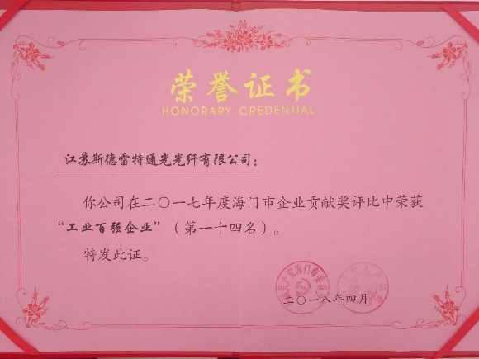
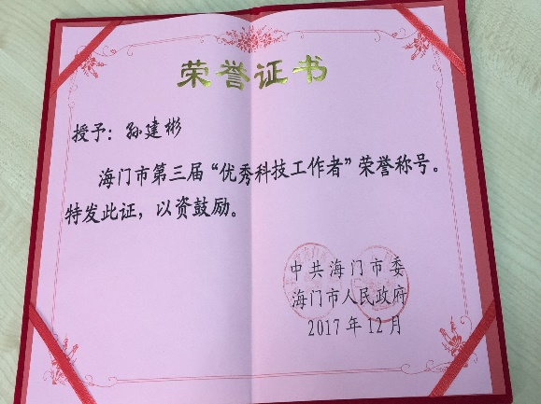
Awards
Most innovative and successful Indian Companies Awards 2018
Home for Star Employees 2018
Model Worker’s Home Award 2018
Top 100 Industrial Enterprises Award 2018
Excellent Technician Award 2017– Sun Jianbin

Slide 15

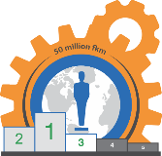
Global Footprint
Sterlite Tech will rank third among the top 5 globally integrated fibre manufacturers by FY'2020
60% of UK's data networks. 90% of Luxembourg,
80% of Panama, 20% of Finland, Sweden and Norway, 20% of UAE, are wired by Sterlite Tech
With its manufacturing presence, Sterlite Tech has 5% of China's market share in optical fibre

Slide 16


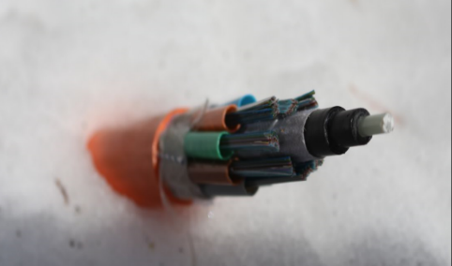
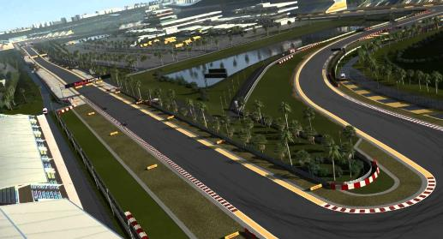
Networks deployed in the most challenging terrains and extreme weather conditions
In the dense Amazonian forests
In Iceland’s extreme snow
In the Himalayan Range
In India’s first Formula 1 race track

Slide 17
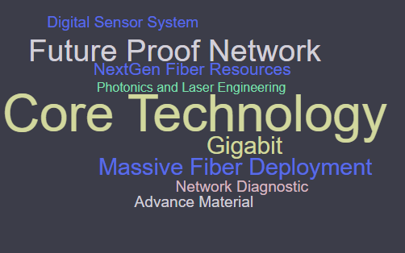

Strong Focus on Technology Innovation
216 GLOBAL PATENTS
Sterlite Tech → 192
China JV → 24
Asia's largest, most advanced Telecom R&D centres
Centre of Excellence
Centre for Smarter Networks

Slide 18
Thank You

